Slide 1
Move Instructions
© 2015 John Sefcovic.

Slide 2
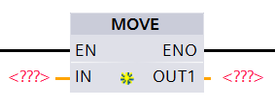
MOVE
The MOVE (MOV) is an output instruction when the rung conditions are true, will place a copy of the IN value, constant or reference Tag, into the OUT Tag.
SIEMENS

Slide 3
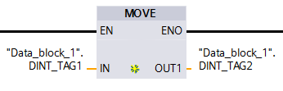
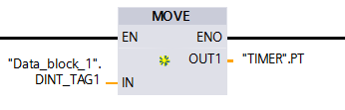
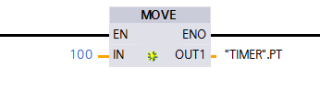
MOVE
ADDRESSING EXAMPLES RSLogix 5000
IN: INTEGER
OUT: INTEGER
IN: INTEGER
OUT: TIMER PRESET
Timer Preset is an Integer value.
IN: CONSTANT VALUE
OUT: INTEGER
The MOVE instruction can only move similar Data Types.
If the Data Types are dissimilar, the IN must first be converted to the OUT Data Type.

Slide 4
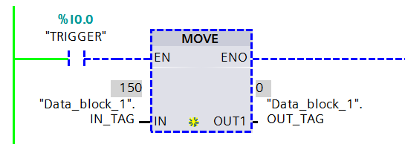
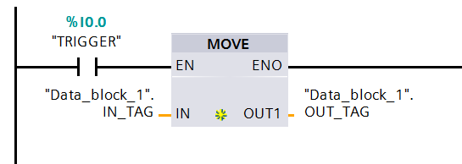
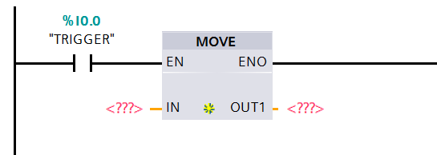
MOVE
When the instruction is first entered, there are two sets of question marks for the IN and OUT values.
When Online and Monitored, the Tag values are shown.
When the Tags are entered, the values are not shown.
The value for the IN tag may be defined in the tag’s table when offline, or in the online Watch Window.

Slide 5
MOVE
OPERATIONS
IN
21,845 _{Decimal}
OUT
BEFORE MOVE
OUT
AFTER MOVE
21,845 _{Decimal}

Slide 6
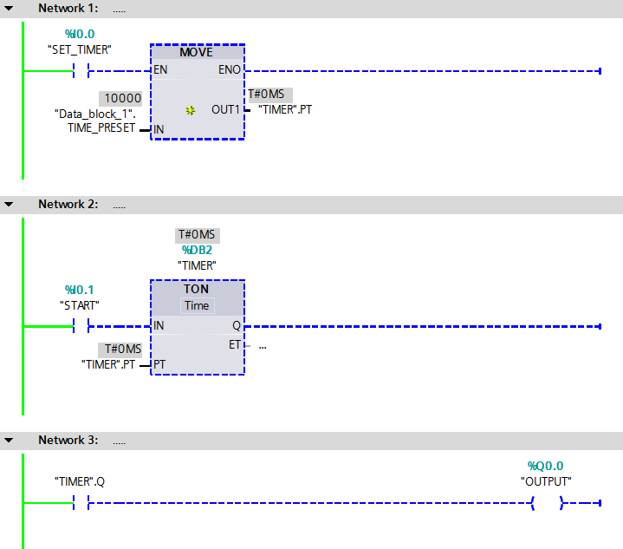
MOVE
The IN is an Integer Tag with a value of 10000.
The OUT is the Timer preset (.PT).
0
10000
OUT
IN
TIMER.PT
TIME_PRESET
0

Slide 7
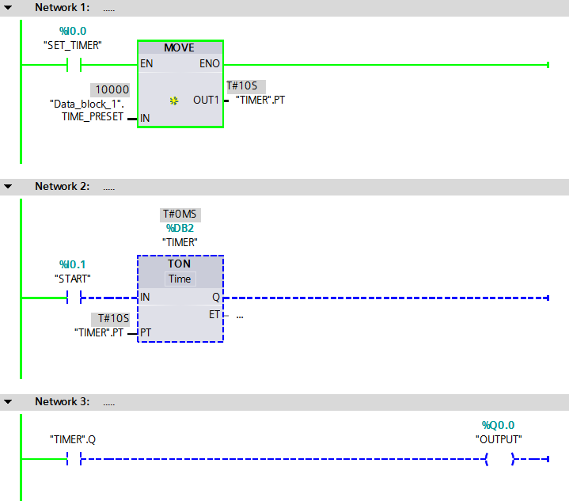
MOVE
When the rung is TRUE, the value of 10000 is moved into the timer’s preset setting the timer to 10 seconds.
10000
10000
SOURCE
DESTINATION
TIME_PRESET
TIMER.PT

Slide 8
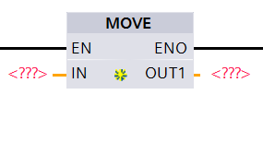
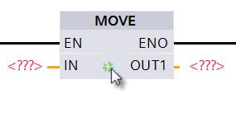
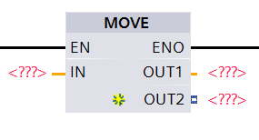
MOVE
The MOVE instruction can have more than one OUT tag.
Place the cursor on the Inset Output marker and left click.
An OUT is added to the MOVE instruction.

Slide 9
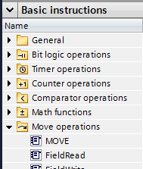

MOVE
The MOVE instruction button is in the Move Operations.
SIEMENS

